Slide 1
Department of Computer Science and Engineering
ANNA UNIVERSITY REGIONAL CAMPUS COIMBATORE
AD3811 & PROJECT WORK
THIRD REVIEW
Title of the project :
Reverse Engineering of Voyager-Based GraphQL APIs for Automated Professional Profile Data Extraction Date : 10.04.2026
Project Guide Name/Designation: | Name / Desn. / CSE Dr.P.Marikkannu AP/CSE
Name and Regn. Number of Students: | Name (Regn. No.) S.Sidharthan (710022243043)

Slide 2
AGENDA
INTRODUCTION
PROBLEM STATEMENT
ABSTRACT
OVERALL DESIGN
MATERIALS AND METHODS
MODULE IMPLEMENTATION
EXPERIMENTAL RESULTS
PERFORMANCE EVALUATION
SCREENSHOT
REFERNCES
CONCLUSION

Slide 3
INTRODUCTION
Professional platforms (LinkedIn, GitHub, X) serve structured data via internal GraphQL APIs
Direct API access is costly, restricted, and rate-limited
This project builds an automated system to extract publicly available professional data
Extended scope: GitHub candidate discovery via keyword search using Scraplin

Slide 4
PROBLEM STATEMENT
No affordable access to professional profile data at scale
Official APIs: LinkedIn charges $0.30–$0.50/profile; X/Twitter $100–$42K/month
Manual collection: 5–10 minutes per profile, error-prone
Existing open-source tools are outdated and break with platform updates
Gap: No unified, transparent, multi-platform extraction solution

Slide 5
ABSTRACT
This system reverse-engineers internal GraphQL APIs of LinkedIn and GitHub
Uses Playwright for browser automation and session management
Scrapling is used for lightweight, fast HTML parsing on GitHub search
Extracts profile data, posts, activity, and media in structured formats
Output: JSON, CSV, PDF — ready for recruitment analytics and research

Slide 6
OVERALL DESIGN
Architecture & Workflow
Goal: Reproduce and extend the LINKSOCIAL user-profile-linkage pipeline using public profile metadata across Google+, Instagram, and Twitter.
Core Pipeline:
-Data Ingestion: Parse raw dataset JSON into standardized, canonical profiles.
-Candidate Pruning: Generate candidate pairs efficiently using bigram Jaccard similarity.
-Feature Extraction: Extract classical algorithms, lexical modern matchers, and deep semantic embeddings.
-Ranking Models: Score and classify pairs using multiple supervised rankers (SGD, LogReg, Random Forest, GBDT).
-Evaluation: Assess linkage on pairwise boundaries and multi-platform anchors.
-Interactive Demo: FastAPI frontend for interactive analyst review and validation.

Slide 7
MATERIALS AND METHODS
Dataset & Technological Stack
Dataset: Public LinkSocial benchmark dataset containing identity groups split by platform co-occurrence (single, pair, and three-platform groups).
Inputs Used: Public metadata including username, full name, and bio/description.
Technology Stack:
-Backend: Python >= 3.12, FastAPI.
-ML Stack: Scikit-Learn (Classical ML), sentence-transformers (BAAI/bge-small-en-v1.5) for GPU-backed semantic embeddings.
Dependency Management: uv.
Methodology Constraints:
-60/40 train-test split to follow original paper evaluation protocols.
-Focused strictly on profile-only features (no image or graph processing) to keep the baseline comparison fair given the public data limitations.

Slide 8
MODULE IMPLEMENTATION
Core Components
Canonical Profile Loader: Standardizes varying raw data schemas into a unified, clean profiles.jsonl data file.
Candidate Pool Generator: Uses bigram Jaccard pruning to aggressively filter down the search space to 20-40 viable candidate links per anchor profile.
Feature Extractors:
Classical: Additive and similarity-based baseline features matching the 2018 methodology.
Lexical Modern: Enhanced character/word-level string matching using modern tools.
Semantic Embedding: High-dimensional textual similarity metrics with cached inferences.
Research UI Frontend: A lightweight, monochrome REST dashboard displaying a candidate linkage graph, an evidence inspector for feature/model scores, and experiment result tables.

Slide 9
EXPERIMENTAL RESULTS
Pairwise Linkage Accuracies (Top-1)
Google+ to Instagram:
1)Unsupervised Baseline: 54.00%
2)Classical LINKSOCIAL (Random Forest): 84.49%
3)Semantic Hybrid GBDT (Ours): 88.20%
Google+ to Twitter:
1) Unsupervised Baseline: 54.89%
2)Classical LINKSOCIAL (Random Forest): 80.48%
3)Semantic Hybrid GBDT (Ours): 84.96%
Instagram to Twitter:
1)Unsupervised Baseline: 78.96%
2)Classical LINKSOCIAL (Random Forest): 91.46%
3)Semantic Hybrid GBDT (Ours): 92.51%

Slide 10
PERFORMANCE EVALUATION
Multi-Platform Linkage Performance
Compared aggregated performance anchors across all three platforms combined:
-Unsupervised Baseline: 61.09% mean accuracy.
-LINKSOCIAL SGD/LogReg: ~74% mean accuracy.
-LINKSOCIAL Random Forest (RF): 83.51% mean accuracy.
-Semantic Hybrid GBDT (Ours): 85.38% mean accuracy.
Analysis: Adding deep semantic embeddings to the classical and lexical feature set significantly outperforms both the raw unsupervised baseline and the original 2018 LINKSOCIAL models. Notably, the original Random Forest approach still holds up surprisingly well as a strong foundation.

Slide 11
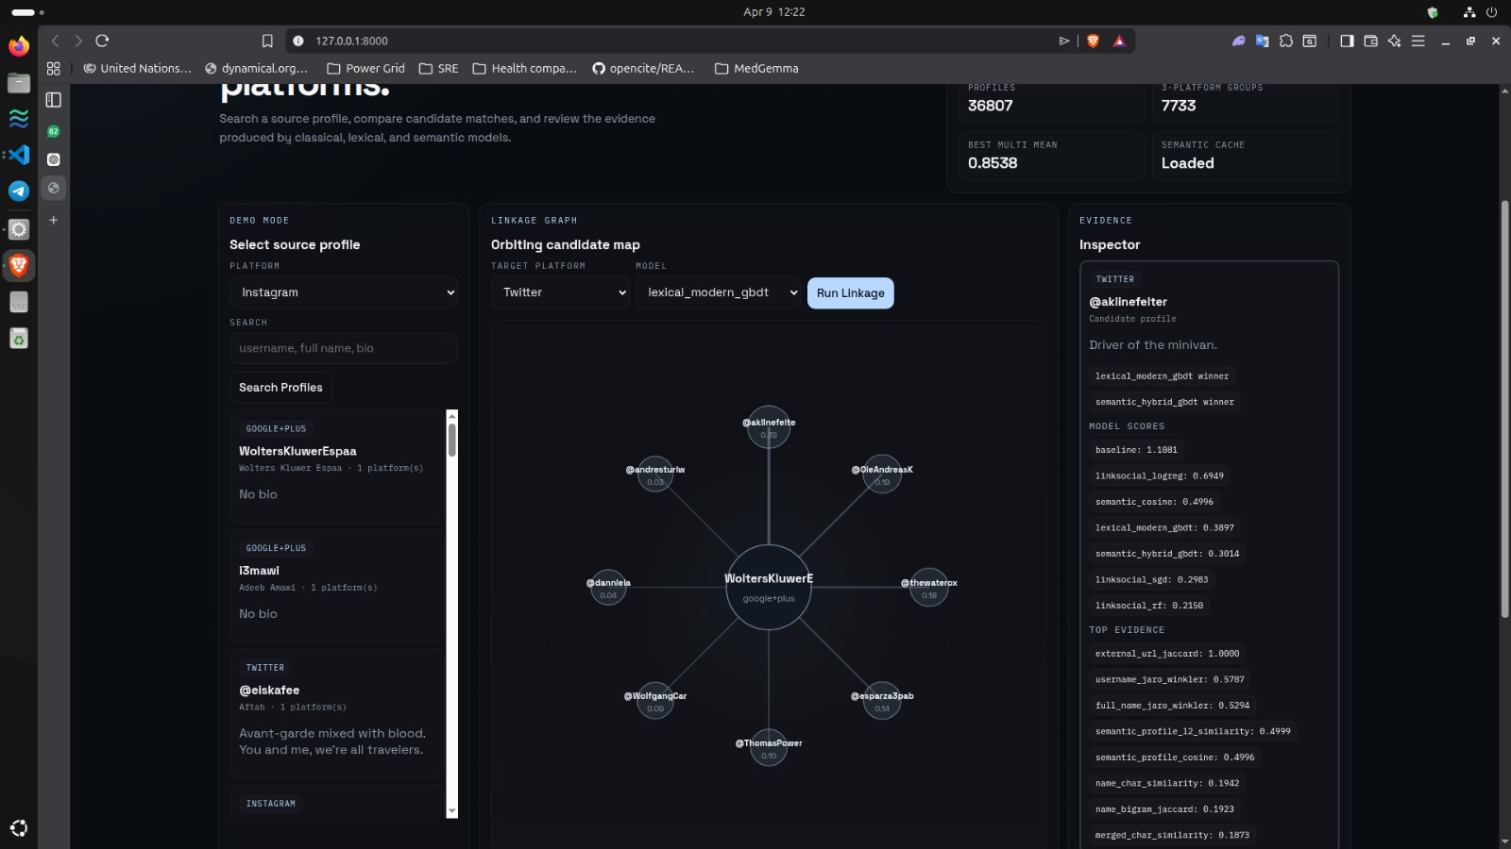
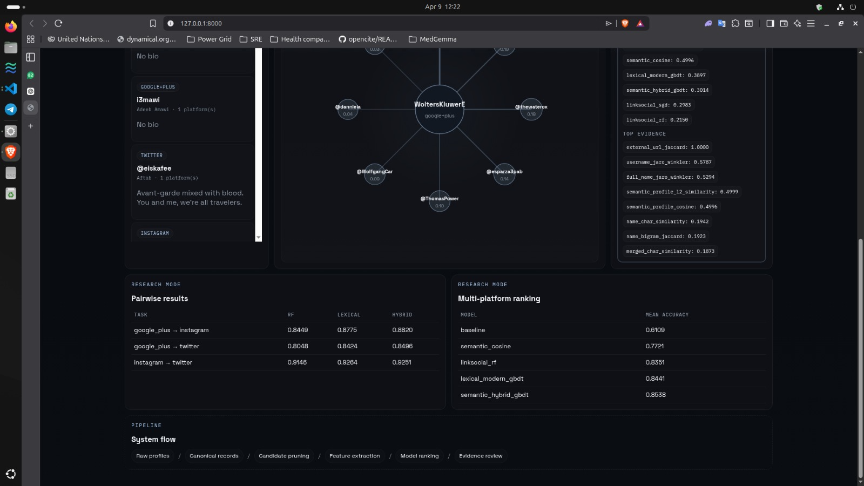
SCREENSHOT

Slide 12
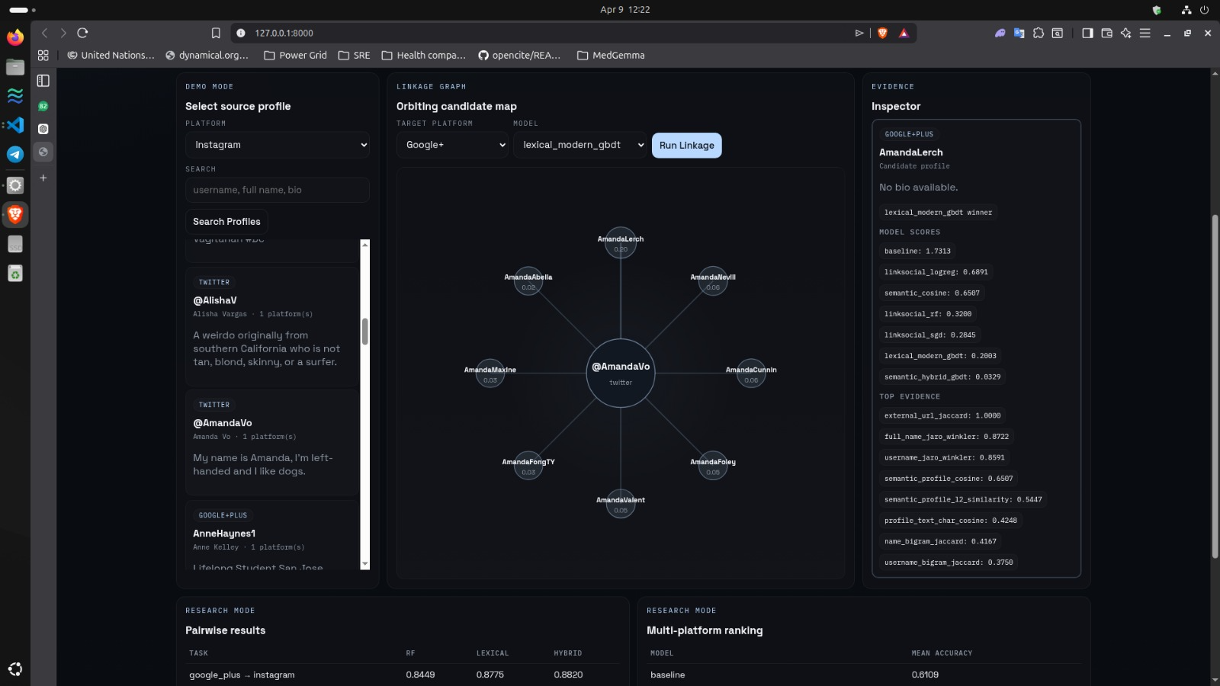

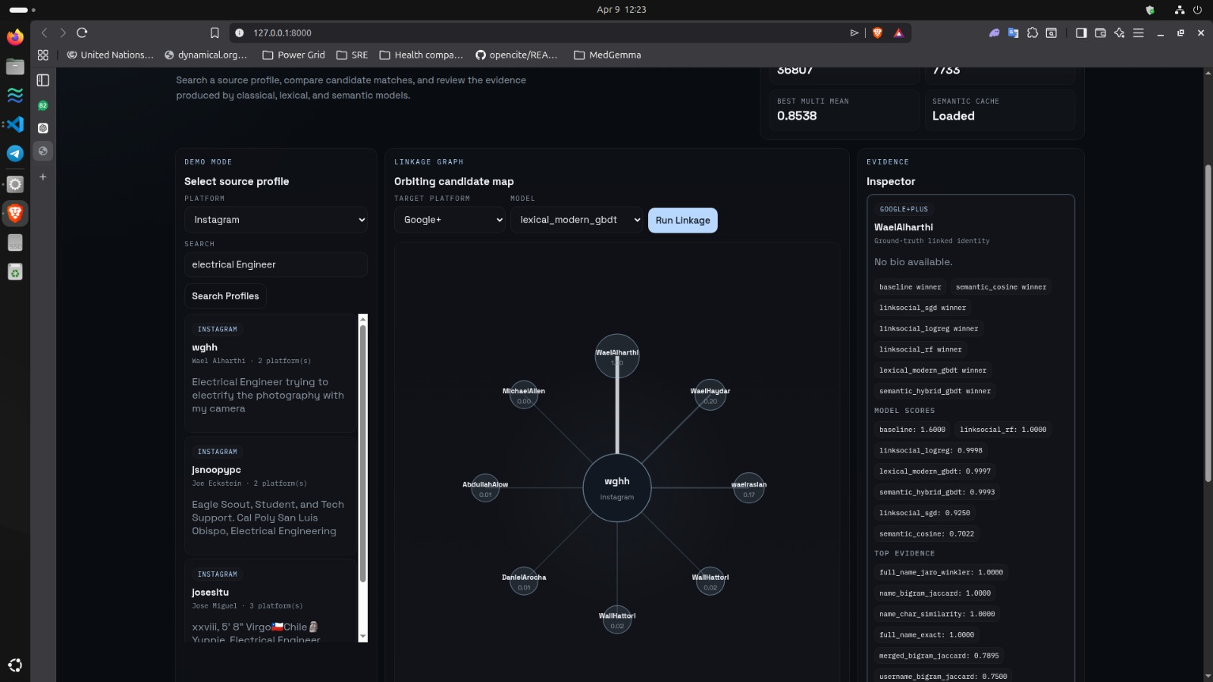

Slide 13
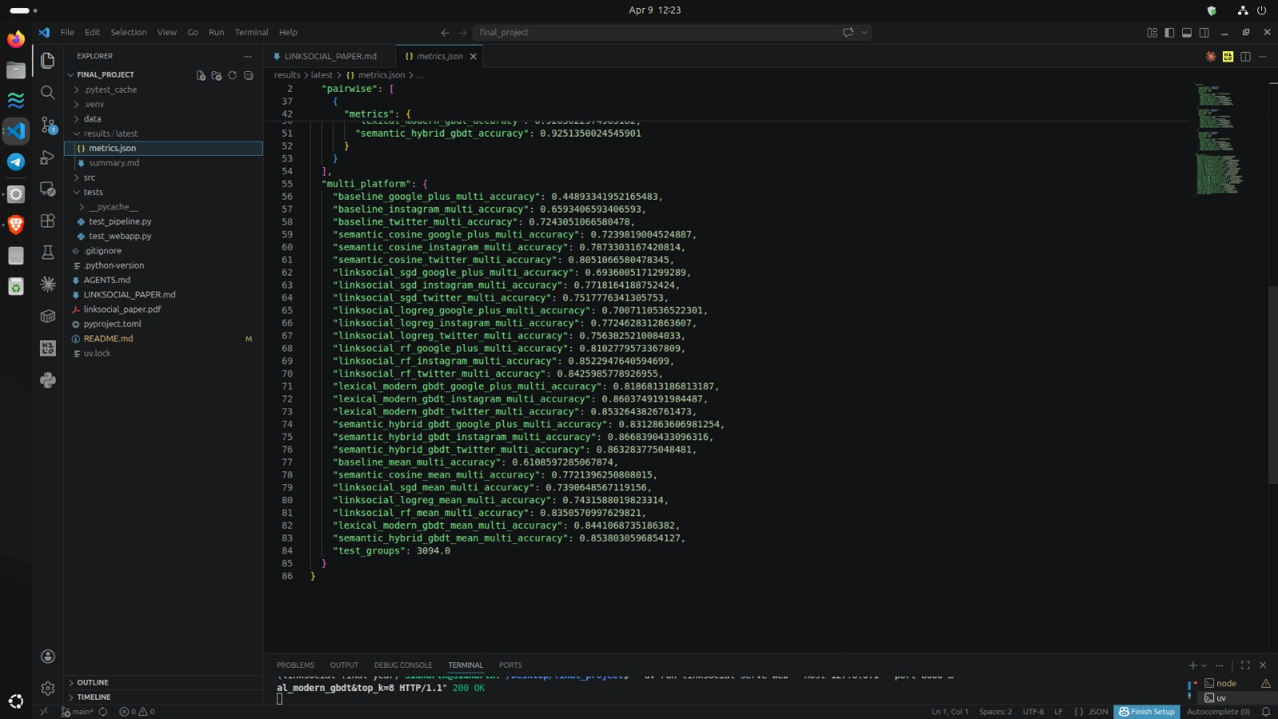
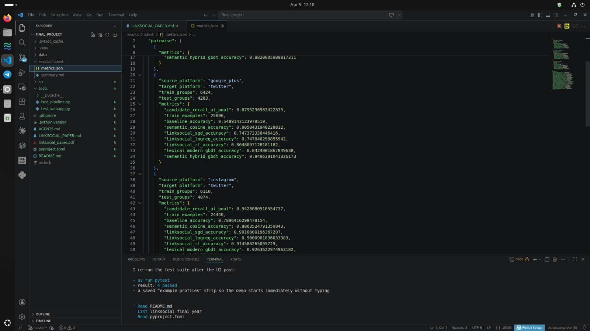
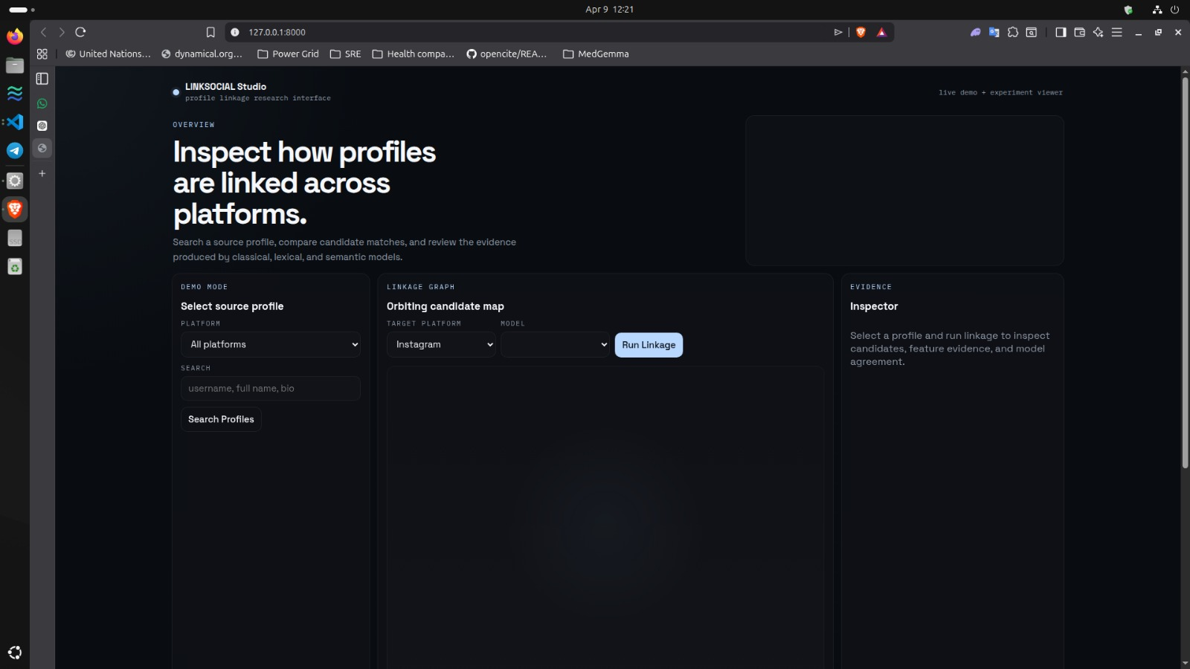
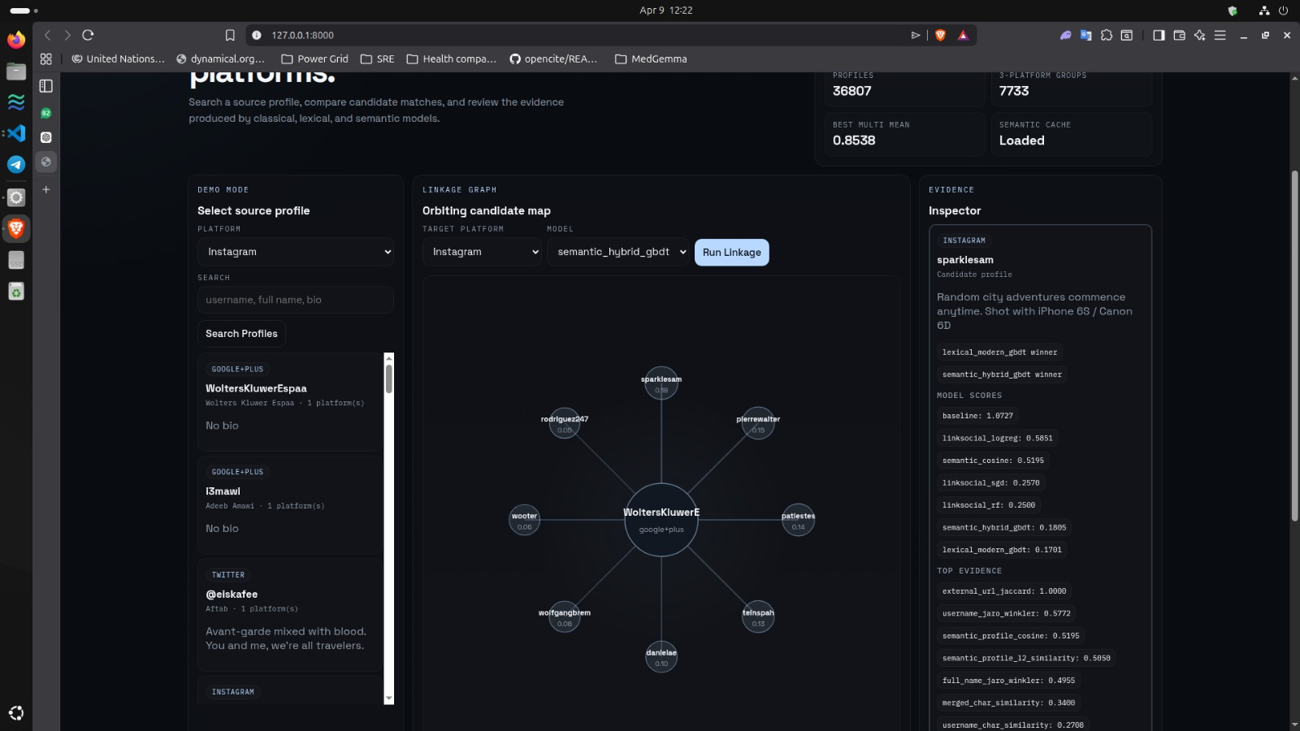

Slide 14
REFERENCES
[1] LINKSOCIAL: Linking User Profiles Across Multiple Social Media Platforms.Vishal Sharma, Curtis E. Dyreson https://ieeexplore.ieee.org/document/8588801/
2] Hartig, O., Pérez, J. (2018). "Semantics and Complexity of GraphQL."
Proceedings of the 2018 World Wide Web Conference, pp. 1155-1164.
DOI: 10.1145/3178876.3186014
[3] Vogel, M., Weber, S., Zirpins, C. (2017). "Experiences on Migrating
RESTful Web Services to GraphQL." International Conference on
Service-Oriented Computing (ICSOC), pp. 283-295.
DOI: 10.1007/978-3-319-69035-3_20
[4] Wittern, E., Cha, A., Davis, J.C., Baudart, G., Mandel, L. (2019).
"An Empirical Study of GraphQL Schemas."
IEEE International Conference on Service-Oriented System Engineering,
pp. 3-13. DOI: 10.1109/SOSE.2019.00011
[5] GitHub GraphQL API v4 Documentation (2024).
Official Documentation. URL: https://docs.github.com/en/graphql
Accessed: February 2026

Slide 15
CONCLUSION
Successes:
Successfully reproduced the 2018 user-profile linkage pipeline and robustly improved upon it. The combination of classical features and modern semantic embeddings proved highly effective for cross-platform linking without needing network interaction graphs.
Practical Finding:
The strongest profile-only approach does not replace the traditional LINKSOCIAL algorithm entirely, but rather extends it with modern continuous text representations.

Slide 16
THANK YOU

